Slide 1
Chapter 8 - Implementing Windows Firewall

Slide 2
Firewall types
Firewalls can be installed on hosts, such as those running Windows Server, or implemented as software in devices, such as routers
Different types of firewalls exist:
  Application-layer gateway
  Circuit-level gateway
  Packet filter
  Stateful multilayer inspection
Notes:
Describe the different kinds of firewalls. Remind the students about the Open Systems Interconnection (OSI) model, and if necessary, display it on the whiteboard so that they can envision the way these firewalls work.
The topic is intended to get the students to think about where they implement firewalls and what they want to configure and control.
20744B
12: Securing network traffic with firewalls and encryption

Slide 3
Well-known ports
Well-known ports designate specific traffic types
The following table shows some common well-known ports
Service | Port | Function
HTTP | 80 | Web traffic
HTTPS | 443 | Secure web traffic
FTP | 20, 21 | File transfer
FTPS | 989, 990 | Secure file transfer
DNS | 53 | Name resolution
SMTP | 25 | Internet mail
TELNET | 23 | Remote login
SSH | 22 | Secure remote login
SNMP | 161, 162 | Network management
Notes:
Discuss some of the well-known ports and how using well-known ports helps firewalls to provide better protection to the network.
20744B
12: Securing network traffic with firewalls and encryption

Slide 4
Network location profiles
The first time that your server connects to a network, you must select a network location
Three network profiles exist:
  Domain networks
  Private networks
  Guest or public networks
Windows Server 2016 includes the ability to have multiple active firewall profiles
Notes:
If possible, reconfigure your virtual machine so that it connects to a new network. Show the students the network location profile option, or display the user interface in Control Panel and discuss the settings.
One of the key points that the students need to understand is that only domain members use the Domain networks profile.
20744B
12: Securing network traffic with firewalls and encryption

Slide 5
Network location profiles
The domain profile applies to networks where the host system can authenticate to a domain controller.
The private profile is a user-assigned profile and is used to designate private or home networks.
Lastly, the default profile is the public profile, which is used to designate public networks such as Wi-Fi hotspots at coffee shops, airports, and other locations.
Notes:
If possible, reconfigure your virtual machine so that it connects to a new network. Show the students the network location profile option, or display the user interface in Control Panel and discuss the settings.
One of the key points that the students need to understand is that only domain members use the Domain networks profile.
20744B
12: Securing network traffic with firewalls and encryption

Slide 6
Network location profiles
Best practices are to create your rules in all three profiles, but only enable the firewall rule group on the profiles that suit your scenarios.
For example, if you are installing a home media sharing application that is only used on a private network then it would be best to create firewall rules in all three profiles, but only enable the firewall rule group containing your rules on the private profile.
Notes:
If possible, reconfigure your virtual machine so that it connects to a new network. Show the students the network location profile option, or display the user interface in Control Panel and discuss the settings.
One of the key points that the students need to understand is that only domain members use the Domain networks profile.
20744B
12: Securing network traffic with firewalls and encryption

Slide 7
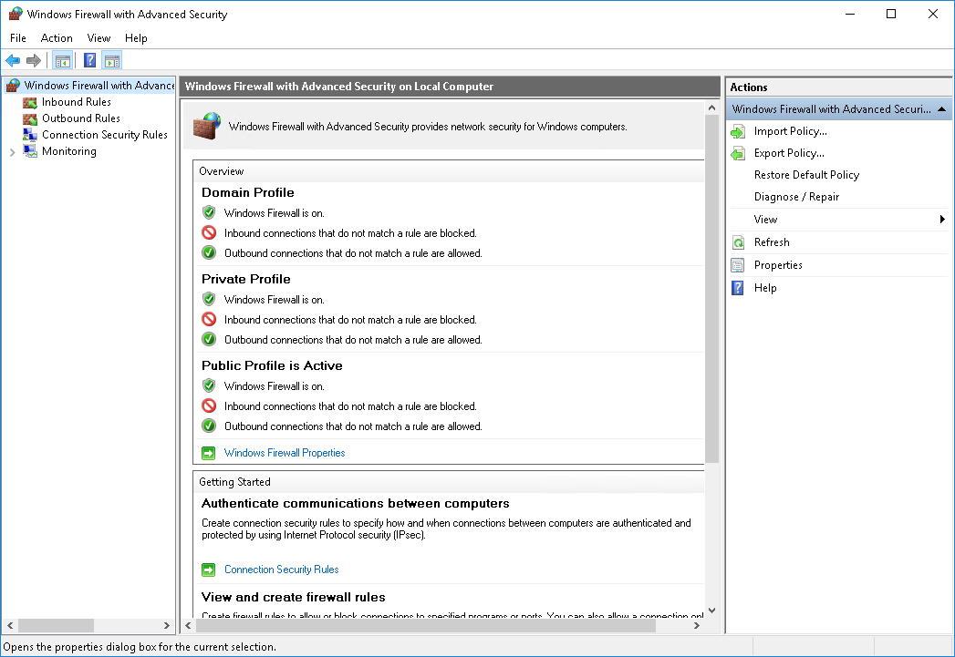
What is Windows Firewall with Advanced Security?
Inbound and outbound rules define which traffic you will allow, block, or secure
Notes:
Note: There is one additional slide in this topic.
Demonstrate the Windows Firewall with Advanced Security interface as you discuss each option. The next topic covers a formal demonstration of inbound rules.
Mention that the default Windows Firewall status is to block all incoming traffic, unless it is solicited or matches a configured rule, and to allow all outgoing traffic, unless it matches a configured rule.
Mention the following rules:
Password policies TCP port 20 blocks outbound traffic.
Remote Desktop allows inbound traffic.
Custom application TCP port 6543 allows inbound traffic.
20744B
12: Securing network traffic with firewalls and encryption

Slide 8
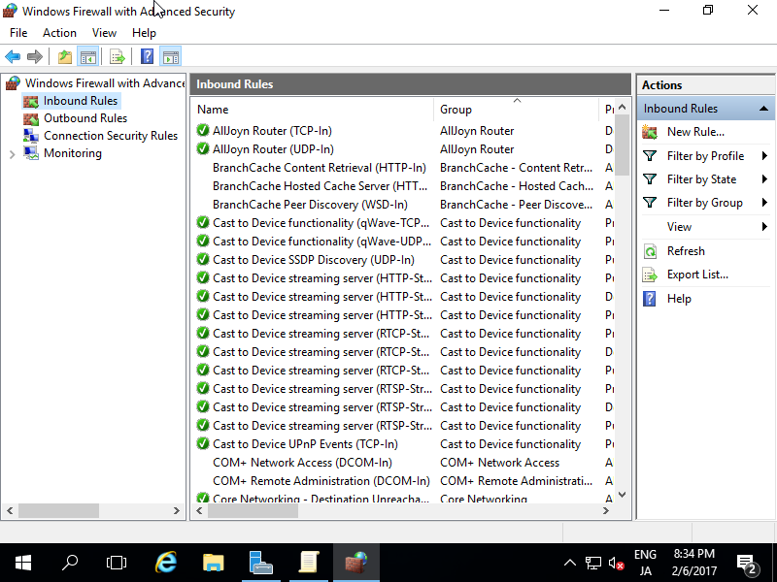
What is Windows Firewall with Advanced Security?

Slide 9
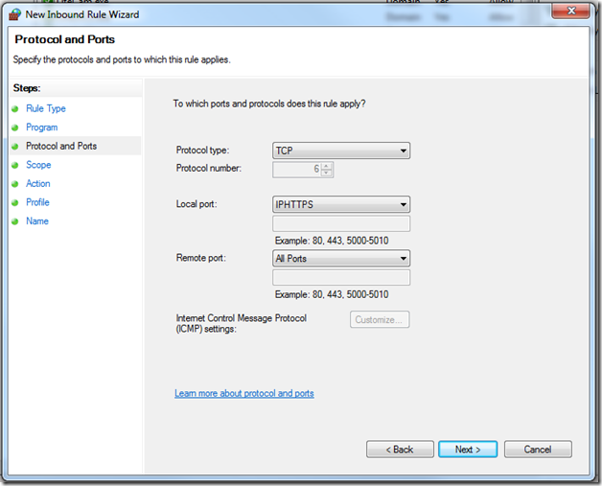
What is Windows Firewall with Advanced Security?

Slide 10
What is Windows Firewall with Advanced Security?
The benefits of Windows Firewall with Advanced security include that it:
Supports filtering for both incoming and outgoing traffic
Integrates firewall filtering and IPsec protection settings
Allows you to configure rules to control network traffic
Provides network location–aware profiles
Enables you to import or export policies
Notes:
This is the second of two slides in this topic.
20744B
12: Securing network traffic with firewalls and encryption

Slide 11
Deploying firewall rules
You can deploy Windows Firewall rules:
  Manually. Use during testing or troubleshooting or for individual computers.
  By using Group Policy. Note that this is the preferred way. Create and test the rules, and then deploy them to a large number of computers.
  By exporting and importing. Use with Windows Firewall with Advanced Security.
  When you import rules, they replace all the current rules.
Always test firewall rules in an isolated, nonproduction environment before you deploy them in production.
Notes:
Explain to the students that they should choose the deployment method for Windows Firewall rules based on how many computers will be affected. If they need to create a firewall rule on hundreds of computers, they should use Group Policy. For a single computer, they can manually configure it.
Stress to the students that they should be very careful when they use Group Policy to configure Windows Firewall rules. Some employees might use applications that need additional ports to be open on their computers, and improperly configured firewall rules might block those applications. We recommend that you test firewall rules in an isolated, nonproduction environment before you deploy them in production.
20744B
12: Securing network traffic with firewalls and encryption

